Slide 1
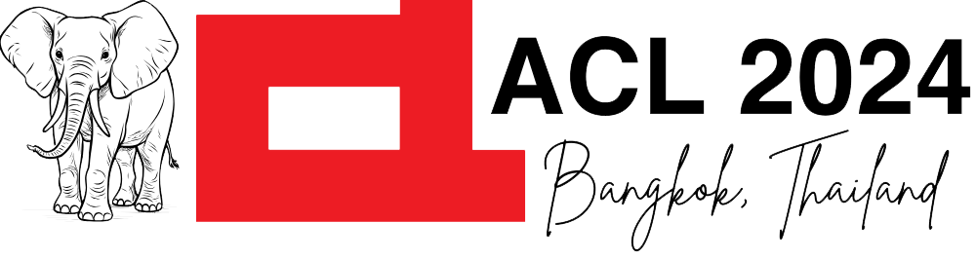



Self-Distillation Bridges Distribution Gap in Language Model Fine-Tuning
¹
²
2024.acl-long.58
³
Zhaorui Yang¹, Tianyu Pang², Haozhe Feng³, Han Wang¹, Wei Chen¹,
Minfeng Zhu^{1✉}, Qian Liu^{2✉}

Slide 2
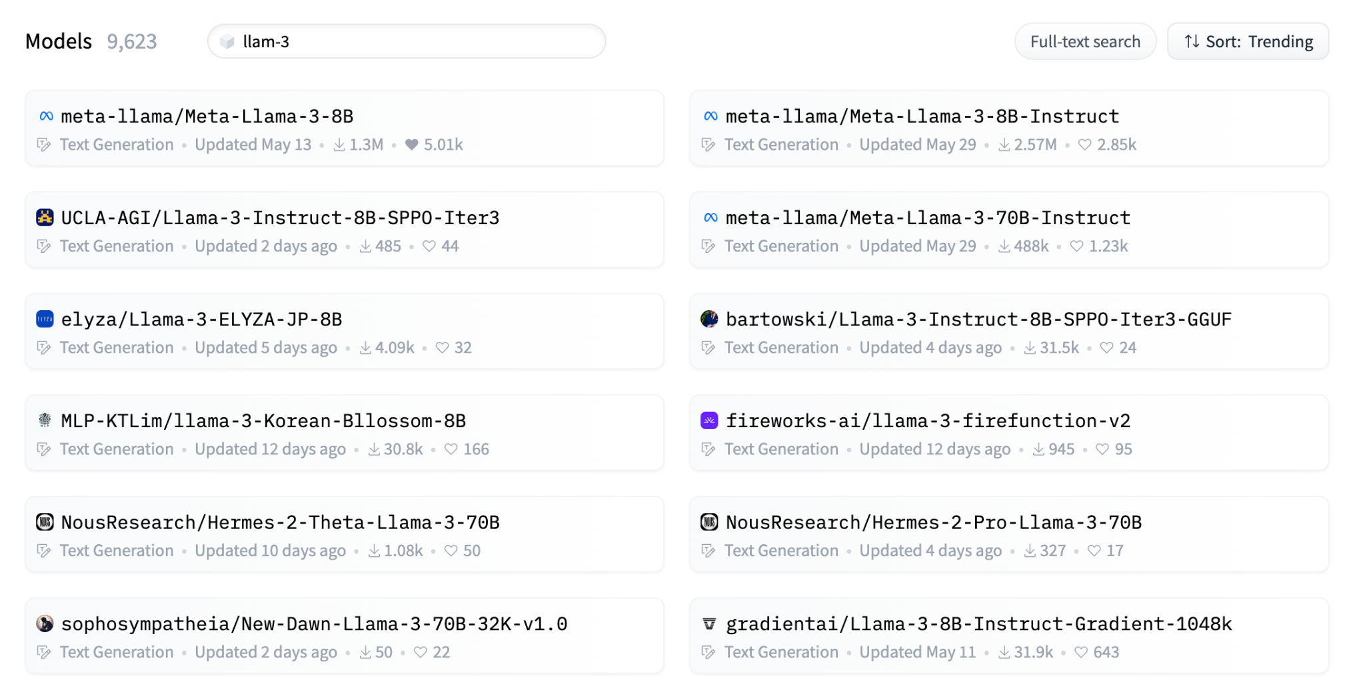
The Landscape of LLM Model Fine-tuning
On 🤗 HuggingFace, thousands of fine-tuned models sprout daily 🌱, from community enthusiasts to big orgs.
9,000
Fine-tuned models
Based on 🦙Llama-3
Notes:
Let’s start with the landscape of LLM model fine-tuning. On huggingface, thousands of fine-tuned models sprout daily, from community enthusiasts to big organizations. For example, there already exists 9,000 fine-tuned models based on the recently released Llama-3 model.

Slide 3
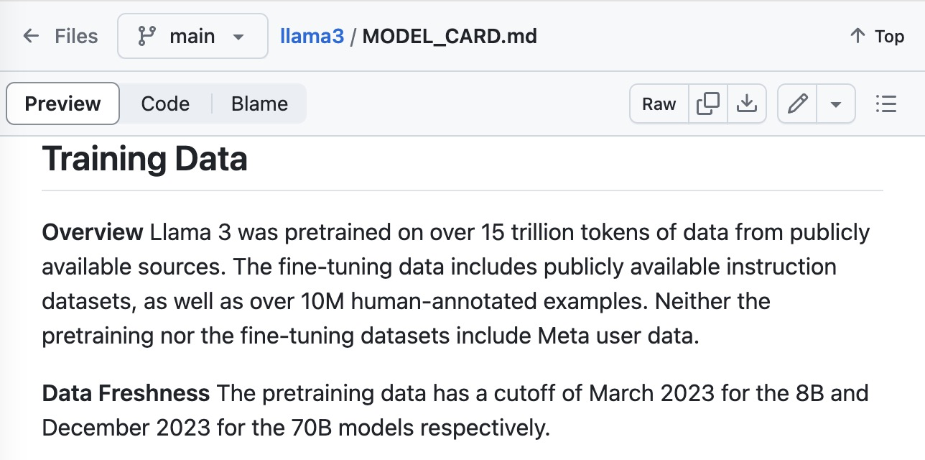
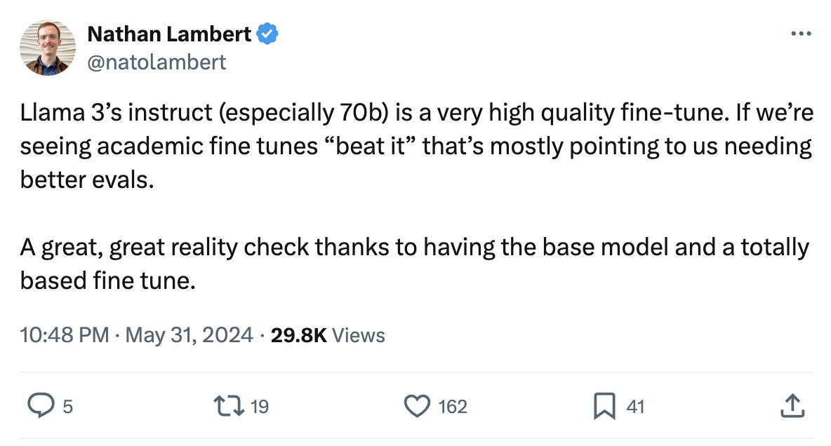
The Challenge of Enhancing Existing Models: Performance
When Meta releases the powerful chat model Llama-3-Instruct without deets on its fine-tuning 🕵️, and you need to enhance its capabilities further on some tasks, sounds easy, right 🤔?
Wrong! Reality is way tougher. 😓
It has already leveraged 10M human examples and never released.
Notes:
However, there are challenges of enhancing existing models. When …, but the reality is way tougher. For example, … Therefore, enhancing its performance through vanilla fine-tuning is non-trivial.

Slide 4
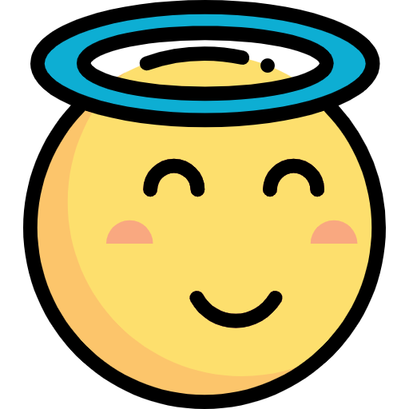

The Challenge of Enhancing Existing Models: Safety
When Meta releases the powerful chat model Llama-3-Instruct without deets on its fine-tuning 🕵️, and you need to enhance its capabilities further on some tasks, sounds easy, right 🤔?
Wrong! Reality is way tougher. 😓
Fine-tuning on Alpaca
Llama-3-Instruct is already an aligned model
Fine-tuning aligned models compromises
safety, even when you do not intend to
Reference: https://arxiv.org/abs/2310.03693
Notes:
Furthermore, fine-tuning also leads to safety degradation. Though …, but the act of fine-tuning on benign datasets such as Alpaca compromises its safety, even when…

Slide 5

The Need for a Better Approach
Can we preserve safety features of the instruct model?
Is it possible to enhance specific capabilities while retaining original strengths?
How do we balance specialization with generalization?
Notes:
Therefore, we need a better approach. We want to …, we also want to enhance… The key question is, how do we balance specialization with generalization?

Slide 6
The Root Cause of Challenge
The primary cause of the fine-tuning challenge lies in the distribution gap between the task data and the original LLM.
Code Generation
Story Telling
Text Summarization
…
Single Task
Llama-3-Instruct capabilities: diverse and aligned with a broad range of human values
Task data: narrowed distribution and focused on certain tasks or domains
Notes:
In this paper, we find that … For example,

Slide 7
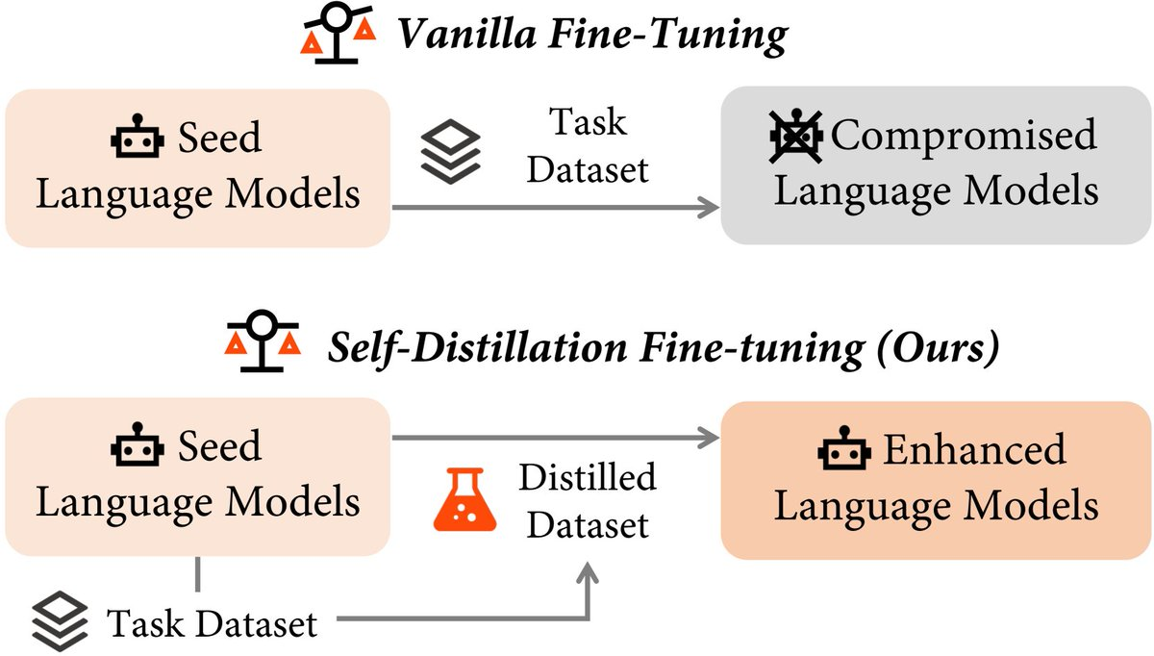
Introducing Self-Distillation Fine-Tuning
Self-Distillation Fine-Tuning (SDFT) aligns task data with the LLMs’ distribution, preserving label supervision while reducing the distribution gap. It achieves this by having the LLM rewrite target labels, integrating new tasks with the model's existing knowledge.
Notes:
Motivated by the findings, we introduce our method, SDFT. …

Slide 8
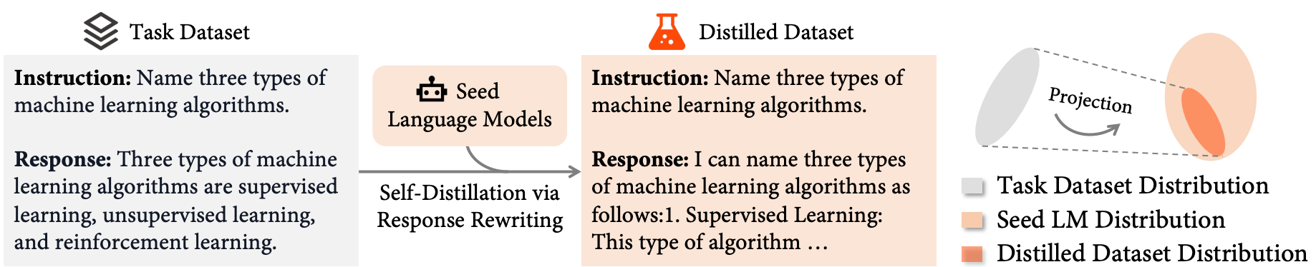
Method: Self-Distillation Fine-tuning
Start with a chat model (i.e., seed language model)
Curate a task dataset targeting areas where the model underperforms
Use the model to rewrite responses in the dataset, creating a distilled dataset
Fine-tune on the distilled dataset, balancing new skills and original capabilities
Notes:
And here are the steps needed.

Slide 9
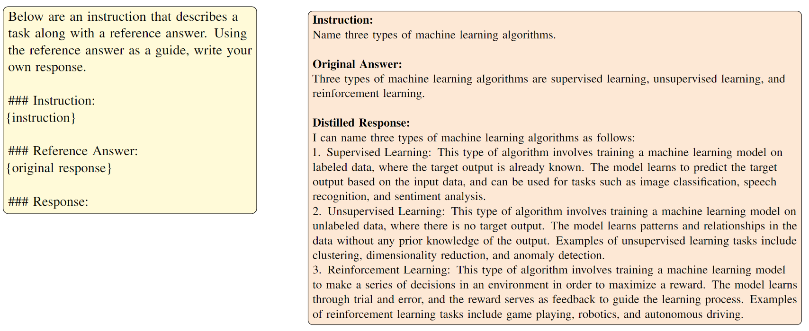
Method: Self-Distillation Fine-tuning
Template for Distillation
Example of the Alpaca dataset
Notes:
Here are the

Slide 10
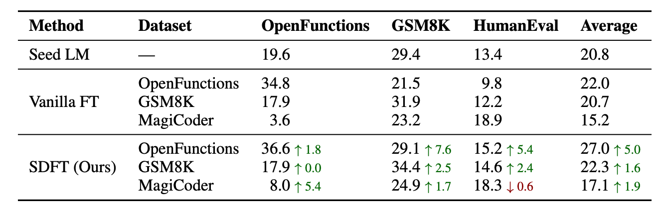
Experiments: SDFT vs. Vanilla Fine-tuning
While both vanilla fine-tuning and SDFT can improve target task performance, SDFT excels in preserving the model's broad capabilities.
Notes:
Now we come to the experiments part. Presented in the table is the performance on downstream tasks after fine-tuning with both vanilla fine-tuning and our method. We highlight performance on target task with blue boxes. As shown in the table, after vanilla fine-tuning, models’ performance on target dataset increase, while it sees a degradation on other tasks. However, with our method, the performance on target task is better or tie, while the degradation on other tasks is largely mitigated.

Slide 11
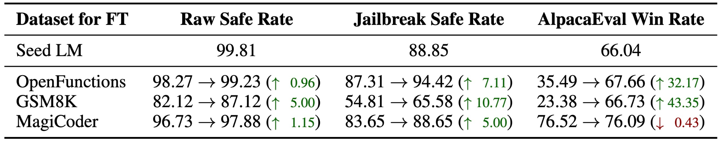
Experiments: SDFT vs. Vanilla Fine-tuning
Vanilla fine-tuning leads to notable degradation in safety and general helpfulness, while SDFT maintains strong alignment after fine-tuning.
Notes:
Moreover, this table shows the results related to safety and general helpfulness. As shown in the table,

Slide 12
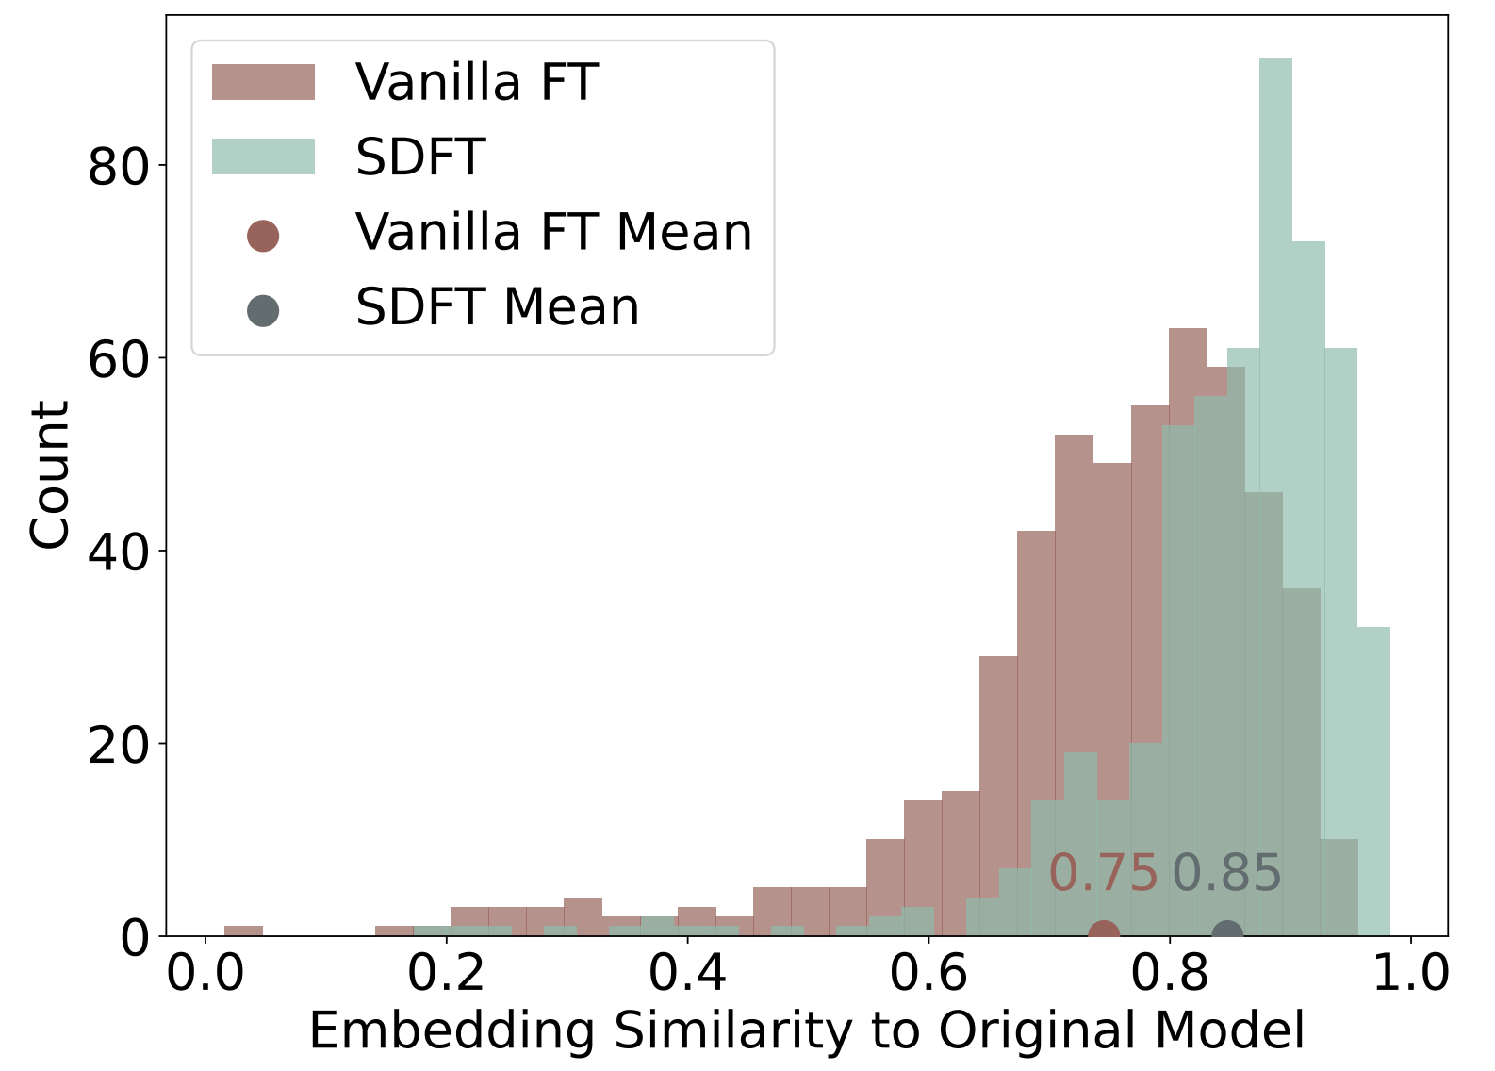
Analysis: Distribution Gap
We assess shifts in model representation by measuring embedding similarity between the original model and the fine-tuned one.
SDFT mitigates the distribution shift, thus alleviating forgetting.
Notes:
We also conducted analysis to verify that our method effectively bridges distribution shift.

Slide 13
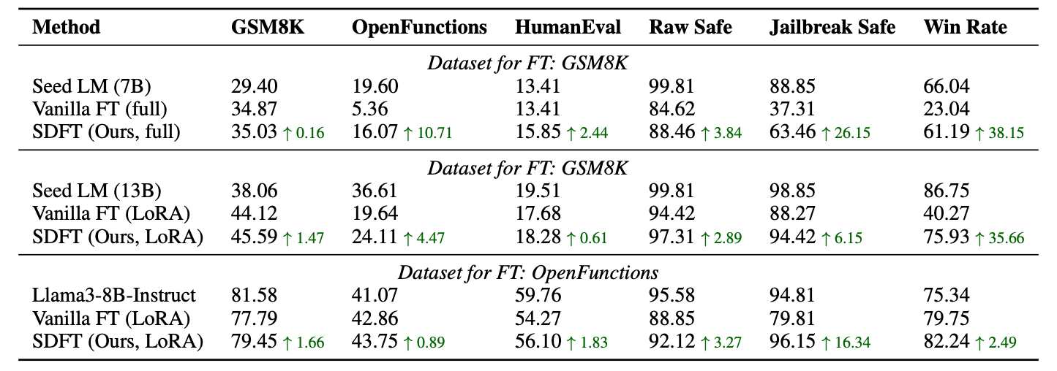
Analysis: Effective across Models
SDFT is superior to vanilla fine-tuning on:
full fine-tuning on Llama-2-7b-chat (significant improvement)
LoRA fine-tuning on Llama-2-13b-chat model
LoRA fine-tuning on Llama-3-8B-Instruct model

Slide 14
Take Away
Finding: distribution shift leads to catastrophic forgetting in vanilla fine-tuning
Method: self-distillation => bridge distribution gap => mitigate forgetting
Experiments: improve the target task performance and keep the original capabilities
Paper: https://aclanthology.org/2024.acl-long.58/
Code: https://github.com/sail-sg/sdft
Notes:
Here is the take away.

Slide 15
Thanks & QA

